Slide 1

Implement Anomaly Detection Sample
Supervised By: Damir Dobric / Prof. Dr. Andreas Pech
Group Name: Team_Anomaly_Detection
Members:
Mahbubur Rahman
Md Zihadul Islam Joni
Md Rakibul Islam

Slide 2
Overview
Introduction
Implementation
Results
Conclusion
References
Project Objective

Slide 3
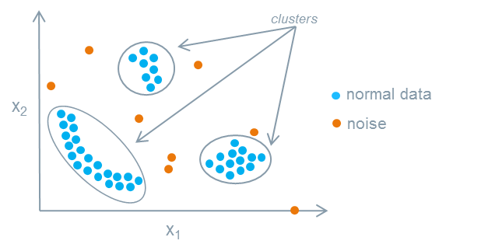
Introduction
WHAT IS ANOMALY?
Deviations from the expected value of an event within a group

Slide 4
PROject objective
HTM (Hierarchical Temporal Memory) is a machine learning algorithm, biologically inspired, both structurally and functionally, by neocortex of a human brain, which uses a hierarchical network of nodes to process timeseries data in a distributed way. Each node, or column, can be trained to learn, and recognize patterns in input data. This can be used to process information, recognize, and identify patterns and make future predictions based on past learning. It is a promising approach for anomaly detection and prediction in a variety of applications in sectors, such as healthcare, finance, etc. We have implemented an anomaly detection sample using HTM, such that it learns multiple simple numeric integer sequences given to HTM model as input and try to learn patterns in it. It will then try to identify anomalies by comparing the real data with the predicted data from learning, with certain threshold of tolerance.

Slide 5
methodology
We are going to use multisequencelearning class of NeoCortex API as base of our project. It will help use with both training our HTM model and using it for prediction. The class works in the following way:
HTM Configuration is taken and memory of connections are initialized. After that, HTM Classifier, Cortex layer and HomeostaticPlasticityController are initialized.
After that, Spatial Pooler and Temporal Memory is initialized.
After that, spatial pooler memory is added to cortex layer and trained for maximum number of cycles.
After that, temporal memory is added to cortex layer to learn all the input sequences. e. Finally, the trained cortex layer and HTM classifier is returned.

Slide 6
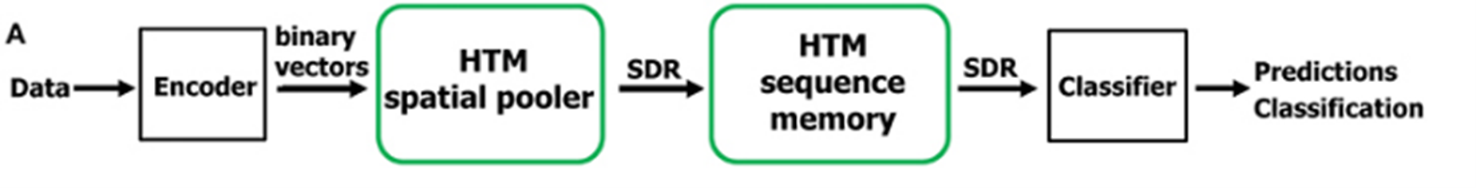
Methodology (Cont.)
Hierarchical Temporal Memory (HTM)
Machine learning algorithm based on the core principles of the Thousand Brains Theory.
Takes inspiration from neocortex of human brain.
Hierarchical Temporal Memory Cortical Learning Algorithm (HTM CLA): Tries to simulate the way neocortex processes information in human brain.
Can be used process information, recognize and identify patterns and make future predictions based on past learning.
Promising approach for anomaly detection and prediction in a variety of applications in sectors, such as healthcare, finance, etc.
6

Slide 7
Methodology (Cont.)
Multisequence learning
Htm cla is good is finding patterns in data
We are using neocortex api, specifically multisequence class, which is based on htm cla.
Multiple number of sequences can be trained with different datatypes.
We are going to use simple numerical integer sequences.
We have to tune hyper-parameters, like encoder and htmconfig, which facilitates training this type of data.

Slide 8
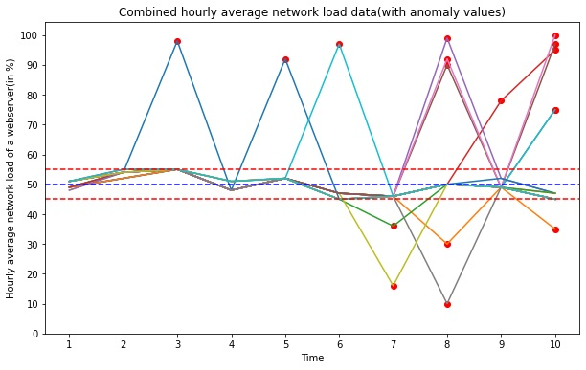
Methodology (Cont.)
Anomaly detection
We have taken an artificially generated dataset and trained our htm engine.
We have added anomalies to random indexes in our prediction data.
We will try to train our data and detect anomalies using trained htm engine.

Slide 9
results
We have achieved false negative rate (FNR) of 0.65, which is high.
We have also achieved false positive rate of 0.24.
It is imperative that fnr needs to be lower.
We need to train htm with more data to improve performance.

Slide 10
conclusion
The AnomalyDetector class maintains a list of predicted values based on the input sequence, and uses the mean and standard deviation of these predicted values to identify values that are significantly different from the expected values.
When a new value is added to the list of predicted values, the mean and standard deviation are updated to reflect the new data. Values that are more than a certain number of standard deviations away from the mean are considered anomalies and removed from the list
In the context of comparing the next appearing value with the last predicted value, the mean and standard deviation can be used to set a tolerance level for how different the predicted and actual values can be before it is considered an anomaly

Slide 11
references
[1] Y. Cui, S. Ahmed, and J. Hawkins, “The HTM Spatial Pooler—A Neocortical Algorithm for Online Sparse Distributed Coding,” Front. Comput. Neurosci. November 2017, vol. 11-2017, doi: 10.3389/fncom.2017.00111.
[2] Ahmad, S., Lavin, A., Purdy, S., and Agha, Z. (2017). Unsupervised real-time anomaly detection for streaming data. Neurocomputing 262, 134–147. doi: 10.1016/j.neucom.2017.04.070.
[3] Mnatzaganian, J., Fokoué, E., and Kudithipudi, D. (2017). A mathematical formalization of hierarchical temporal memory's spatial pooler. Front. Robot. AI 3:81. doi: 10.3389/frobt.2016.00081.
[4] K. Mountcastle, V. B. (1997). The columnar organization of the neocortex. Brain 120, 701–722. doi: 10.1093/brain/120.4.701.
[5] Olshausen, B. A., and Field, D. J. (2004). Sparse coding of sensory inputs. Curr. Opin. Neurobiol. 14, 481–487. doi: 10.1016/j.conb.2004.07.007.
[6] Y. Cui, S. Ahmed, and J. Hawkins, “Continuous online sequence learning with an unsupervised neural network model,” Neural Computation, Volume 28, Issue 11, November 2016, pp 2474–2504, doi: 10.1162/NECO_a_00893

Slide 12
Thank you

